Slide 1
Chapter 20 – Text Mining
Data Mining for Business Analytics in R
Shmueli, Bruce & Patel

Slide 2
Text data
Up to now we have been dealing with structured quantitative data
Numerical
Binary (yes/no)
Multicategory
Now we turn to unstructured text

Slide 3
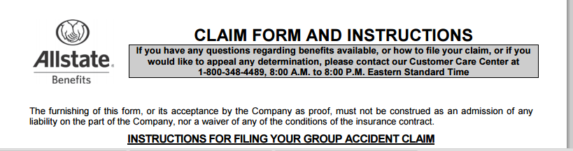
Applications of Text Mining
Insurance fraud – notes in claim forms can be mined and transformed into predictor variables for a predictive model
The model is trained on prior claims in two classes – found to be fraudulent, and not found to be fraudulent
The model is then applied to new claims

Slide 4
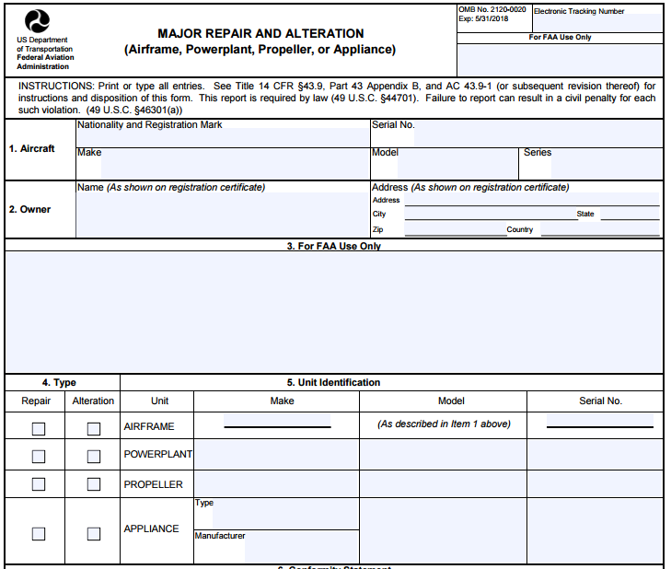
Applications, cont.
Maintenance or support tickets often contain text fields
These fields could be mined to classify ticket in several ways:
How urgent?
How much time to fix?
What category of technician is needed to fix?

Slide 5
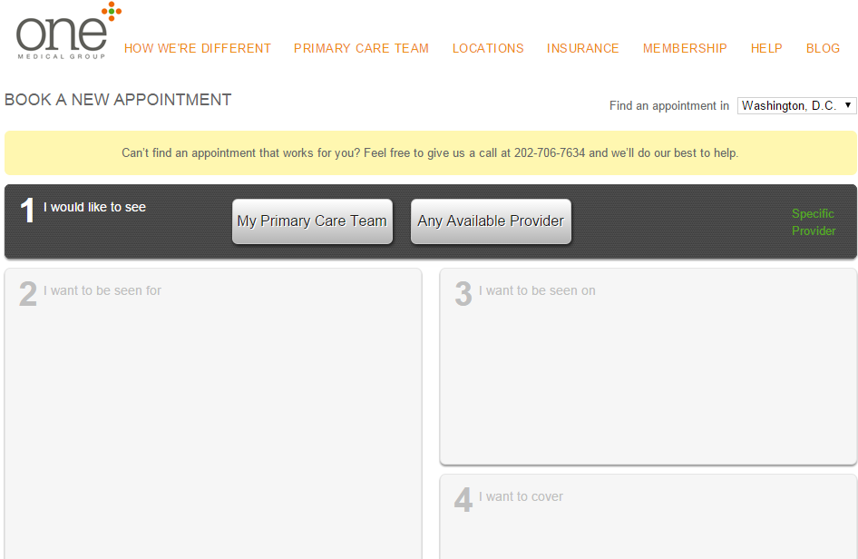
Applications, cont.
Medical triage/diagnosis
Clinics could use patient online appointment request forms to route requests
Admin asst.
Nurse
Doctor

Slide 6
What exactly is text mining?
Classify (label) thousands of documents
Extension of predictive modeling (our focus)
Extract meaning from a single document – interpreting it like a human reads language
“Natural language processing” (very ambitious, not predictive modeling, not our focus)

Slide 7
Classification (labeling) and clustering
No attempt to extract overall document meaning from a single document
Focus is on assigning a label or class to numerous documents
As with numerical data mining, the goal is to do better than guessing

Slide 8
“Bag-of-words”
Grammar, syntax, punctuation, word order are ignored
The document is considered as a “bag of words”
This approach is, nonetheless, effective when the goal is to decide which category or cluster a document falls in
A typical application is supervised learning
Requires lots of documents (a corpus)*
Do not need 100% accuracy
*“Corpus” often refers to a fixed standard set of documents that many researchers can use to develop and tune text mining algorithms.

Slide 9
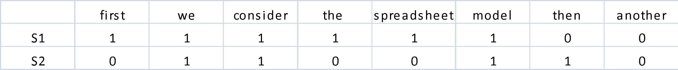
The spreadsheet model of text
Columns are terms
Rows are documents
Cells indicate presence/absence (or frequency) of terms in documents
Consider the two sentences:
S1 First we consider the spreadsheet model
S2 Then we consider another model
Here is the resulting spreadsheet, using presence/absence:

Slide 10
Need to turn text into a matrix
For the two documents (sentences S1 and S2) that we looked at earlier, the process of producing a matrix is simple. We had
Words
Spaces
Periods
Each word is preceded or followed by a space or period – a delimiter.
Real text is more complicated

Slide 11
Lots of things to process besides words…
Numbers (including dates, percents, monetary amounts), e.g. from Google Annual Report 2014:
We considered the historical trends in currency exchange rates and determined that it was reasonably possible that changes in exchange rates of 20% could be experienced in the near term. If the U.S. dollar weakened by 20% at December 31, 2013 and 2014, the amount recorded in AOCI related to our foreign exchange options before tax effect would have been approximately $4 million and $686 million lower at December 31, 2013 and December 31, 2014, and the total amount of expense recorded as interest and other income, net, would have been approximately $123 million and $90 million higher in the years ended December 31, 2013 and December 31, 2014. If the U.S. dollar strengthened by 20% at December 31, 20013 and December 31, 2014, the amount recorded in accumulated AOCI related to our foreign exchange options before tax effect would have been approximately $1.7 billion and $2.5 billion higher at December 31, 2013 and December 31, 2014, and the total amount of expense recorded as interest and other income, net, would have been approximately $120 million and $164 million higher in the years ended December 31, 2013 and December 31, 2014.

Slide 12
Email addresses, url’s, stray characters introduced by file conversions, …
Sender: Distribution list for statistical items of interest <WSS-ELECTRONIC-MAIL-LIST@LISTS.MITRE.ORG> From: "Massimini, Vince" <svm@mitre.org> Subject: Comparing the Maximal Procedure to Permuted Blocks Randomization To: <WSS-ELECTRONIC-MAIL-LIST@LISTS.MITRE.ORG> Precedence: list List-Help: <mailto:LISTSERV@LISTS.MITRE.ORG?body=INFO%20WSS-ELECTRONIC-MAIL-LIST>
For more WSS events, see washstat.org WSS Public Health/Biostatistics Section and NCI Division of Cancer Preventi= on Jointly Sponsored Event: =20
SPEAKER: Vance W. Berger, PhD National Cancer Institute and University of = Maryland Baltimore County and Klejda Bejleri, BS Biometry and Statistics, D= epartment of Biological Statistics and Computational Biology, Cornell Unive= rsity, Ithaca, NY 14853 =20 TITLE: Comparing the Maximal Procedure to Permuted Blocks Randomization
TIME AND PLACE: Monday, June 8th NCI Shady Grove, 9609 Medical Center Drive= , Rockville MD Room 5E30/32. Bring photo ID, allow time to get through secu= rity

Slide 13
Proper nouns & terms specific to a particular field
From Techsmith corporate information: All-In-One Capture, Camtasia, Camtasia Studio, Camtasia Relay, Coach's Eye, DubIt, EnSharpen, Enterprise Wide, Expressshow, Jing, Morae, Rich Recording Technology (RRT), Snagit, Screencast.com, ScreenChomp, Show The World, SmartFocus, TechSmith, TechSmith and T Design logo, TechSmith Fuse, TechSmith Relay, TSCC, and UserVue are marks or registered marks of TechSmith Corporation.
From medical journal: Eight hundred elderly women and men from the population-based Framingham Osteoporosis Study had BMD assessed in 1988-1989 and again in 1992-1993. BMD was measured at femoral neck, trochanter, Ward's area, radial shaft, ultradistal radius, and lumbar spine using Lunar densitometers. (Risk Factors for Longitudinal Bone Loss in Elderly Men and Women: The Framingham Osteoporosis Study, Journal of Bone and Mineral Research Volume 15, Issue 4, pages 710–720, April 2000)

Slide 14
Tokenization
We need to move from a mass of text to useful predictor information
The first step is to separate out and identify individual terms
The process by which you identify delimiters and use them to separate terms is called tokenization. The resulting terms are also called tokens.

Slide 15
Preprocessing
Goal – reduction of text (also called vocabulary reduction) without losing meaning or predictive power
Stemming
Reducing multiple variants of a word to a common core
Travel, traveling, traveled, etc. -> travel
Ignore case
Frequency filters can eliminate terms that
Appear in nearly all documents
Appear in hardly any documents

Slide 16
Preprocessing, cont.
Punctuation characters and extra white space can be removed, and treated as delimiters
Remove terms that are on a stoplist (stopwords)
Typically is done to reduce size and noise by getting rid of very common terms
Illustrated with the default “cnglish” stoplist that comes with R’s tm

Slide 17
Preprocessing, cont.
Frequency vs. presence/absence
Normalization, when the presence of a type of term might be important but we don’t need the specific term. For example
Replace john@domain.com with “email token”
Replace www.domain.com with “url token”

Slide 18
Post-reduction matrix
Columns are documents, rows are terms
Options for cell entries:
0/1 (presence absence)
Frequency count
TF-IDF (term frequency – inverse document frequency)
TF = frequency of term
IDF = log of inverse of the frequency with which documents have that term
There are varying definitions of both TF and IDF, hence of TF-IDF
Bottom line:
TF-IDF is high where a rare term is present or frequent in a document
TF-IDF is near zero where a term is absent from a document, or abundant across all documents

Slide 19
Using R’s tm package with simple example
S1. this is the first sentence.
S2. this is a second sentence.
S3. the third sentence is here.
enter the text as a corpus:
text <- c("this is the first sentence",
"this is a second sentence",
"the third sentence is here")
corp <- Corpus(VectorSource(text))

Slide 20
Producing the term-document matrix
tdm <- TermDocumentMatrix(corp)
inspect(tdm)
Output
<<TermDocumentMatrix (terms: 7, documents: 3)>>
Non-/sparse entries: 12/9
Sparsity : 43%
Maximal term length: 8
Weighting : term frequency (tf)
Docs
Terms 1 2 3
first 1 0 0
here 0 0 1
second 0 1 0
sentence 1 1 1
the 1 1 1
third 0 0 1
this 1 1 0
The term “first” does not occur in document 3

Slide 21
From terms to concepts – Latent Semantic Indexing (LSI)
The post-reduction term/document matrix is often still huge – too big for easy processing
Recall how, with principal components, we derived a small set of synthetic predictor variables, each of which was a linear combination of “like-minded” original variables.
Latent semantic indexing does something similar for text – it maps multiple terms to a small set of concepts.

Slide 22
Intuitive explanation - LSI
For example: if we inspected our document collection, we might find that each time the term “alternator” appeared in an automobile document, the document also included the terms “battery” and “headlights.” Or each time the term “brake" appeared in an automobile document, the terms “pads” and “squeaky” also appeared. However, there is no detectable pattern regarding the use of the terms “alternator” and “brake” together. Documents including “alternator” might or might not include “brake” and documents including “brake” might or might not include “alternator.” Our four terms, battery, headlights, pads, and squeaky describe two different automobile repair issues: failing brakes and a bad alternator.
Analytic Solver Platform, XLMiner Platform, Data Mining User Guide, 2014, Frontline Systems, p. 245}

Slide 23
Extracting Meaning?
It may be possible to use the concepts to identify themes in the document corpus, and clusters of documents sharing those themes.
Often, however, the concepts do not map in obvious fashion to meaningful themes.
Their key contribution is simply reducing the vocabulary – instead of a matrix with thousands of columns, we can deal with just a dozen or two.

Slide 24
A predictive model
Now we have a clean, structured dataset similar to what we have used in our numerical data mining:
Class identifications (labels) for training
Numerical predictors

Slide 25
Example: Classify posts as auto-related, or electronics-related; here’s a sample post:
From: smith@logos.asd.sgi.com (Tom Smith) Subject: Ford Explorer 4WD -
do I need performance axle?
We’re considering getting a Ford Explorer XLT with 4WD and we have the
following questions (All we would do is go skiing - no off-roading):
1. With 4WD, do we need the “performance axle” - (limited slip axle). Its
purpose is to allow the tires to act independently when the tires are on
different terrain.
2. Do we need the all-terrain tires (P235/75X15) or will the all-season
(P225/70X15) be good enough for us at Lake Tahoe?
Thanks,
Tom
–
================================================
Tom Smith Silicon Graphics smith@asd.sgi.com 2011 N. Shoreline Rd. MS
8U-815 415-962-0494 (fax) Mountain View, CA 94043
================================================

Slide 26
Import the data, create document labels:
library(tm)
# step 1: import and label records
# read zip file into a corpus
corp <- Corpus(ZipSource("AutoElectronics.zip",
recursive = T))
# create an array of records labels
label <- c(rep(1, 1000), rep(0, 1000))
“reach into subdirectories while getting documents”
1000 1’s which will be used later to label the first 1000 documents, which we know are auto, and 1000 0’s to label the remainder, which are electronic

Slide 27
Preprocess the text
(function tm_map)
# tokenization
corp <- tm_map(corp, stripWhitespace)
corp <- tm_map(corp, removePunctuation)
corp <- tm_map(corp, removeNumbers)
# stopwords
corp <- tm_map(corp, removeWords, stopwords("english"))
# stemming
corp <- tm_map(corp, stemDocument)

Slide 28
Produce the Concept Matrix
# step 3: TF-IDF and latent semantic analysis
# compute TF-IDF
tdm <- TermDocumentMatrix(corp)
tfidf <- weightTfIdf(tdm)
# extract (20) concepts
library(lsa)
lsa.tfidf <- lsa(tfidf, dim = 20)
# convert to data frame
words.df <- as.data.frame(as.matrix(lsa.tfidf$dk))

Slide 29
Now run a standard predictive model on the Concept Matrix
# sample 60% training data
training <- sample(c(1:2000), 0.6*2000)
# run logistic model on training
trainData = cbind(label = label[training], words.df[training,])
reg <- glm(label ~ ., data = trainData, family = 'binomial')
# compute accuracy on validation set
validData = cbind(label = label[-training], words.df[-training,])
pred <- predict(reg, newdata = validData, type = "response")
# produce confusion matrix
library(caret)
confusionMatrix(ifelse(pred>0.5, 1, 0), label[-training])
Output
> confusionMatrix(ifelse(pred>0.5, 1, 0), label[-training])
Confusion Matrix and Statistics
Reference
Prediction 0 1
0 385 16
1 9 390
Accuracy : 0.9688
The high accuracy shows the posts are very separable

